Slide 1
Graph Algorithm

Slide 2
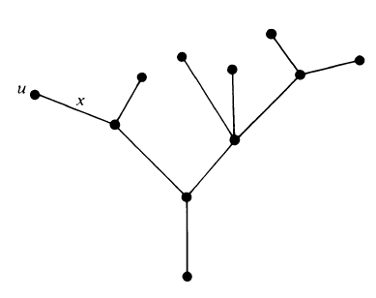
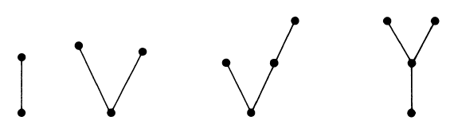
TREES & GRAPHS
A tree is connected graph without any circuit.
Tree has to be a simple graph, that is, having neither a self loop nor parallel edges.

Slide 3
TREES & ITS PROPERTIES
“A connected acyclic graph is called a tree.”
There is one and only one path between every pair of vertices in a tree, T.
Conversely It can be said:
If in a graph G there is one and only one path between every pair of vertices, G is a Tree
A tree with n vertices has n-1 edges

Slide 4
TREES & GRAPHS
A graph G with n vertices is called a tree if:
G is connected and is circuitless, or
G is connected and has n-1 edges, or
G is circuitless and has n-1 edges, or
There is exactly one path between every pair of vertices in G, or
G is minimally connected graph
Notes:
A graph is said to be minimally connected if removal of any one edge from it disconnects the graph. A minimally connected graph has no cycles.

Slide 5
SPANNING TREES:
“A tree T is said to be a spanning tree of a connected graph G if T is a subgraph of G and T contains all the vertices of G.”
Spanning tree is sometimes referred to as a skeleton of G.
Spanning trees are the largest (with maximum number of edges) trees, so also called maximal tree subgraph or maximal tree of G.

Slide 6
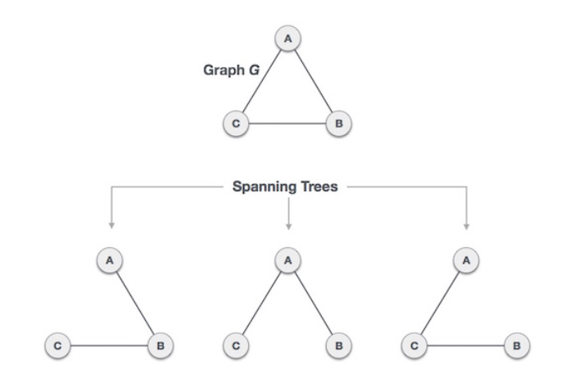
SPANNING TREES

Slide 7
Properties of Spanning Tree
A connected graph G can have more than one spanning tree.
All possible spanning trees of graph G, have the same number of edges and vertices.
The spanning tree does not have any cycle (loops).
Removing one edge from the spanning tree will make the graph disconnected, i.e. the spanning tree is minimally connected.
Adding one edge to the spanning tree will create a circuit or loop, i.e. the spanning tree is maximally acyclic.

Slide 8
Properties of Spanning Tree
Spanning tree has n-1 edges, where n is the number of nodes (vertices).
A complete undirected graph can have maximum n^{n-2} number of spanning trees, where n is the number of nodes.
For Example:
n is 3,
hence 3³⁻² = 3 spanning trees are possible.

Slide 9
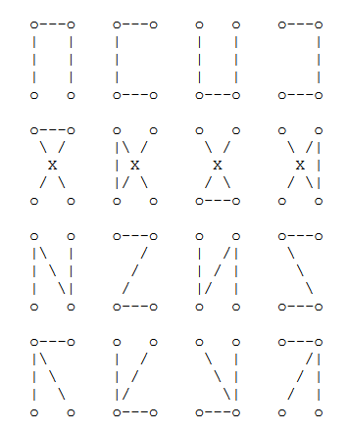
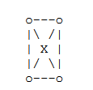
SPANNING TREES
16 Spanning Trees
n is 4,
4⁴⁻² = 16 spanning trees are possible.

Slide 10
Graph Classifications
There are several common kinds of graphs
Directed or undirected
Cyclic or acyclic
Weighted or unweighted

Slide 11
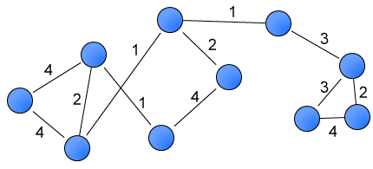
Weighted Graphs
Graphs can be classified by whether or not their edges have weights
Weighted graph: edges have a weight
Weight typically shows cost of traversing
Example: weights are distances between cities

Slide 12
Graphs Types on Direction & Weights
Undirected & Unweighted: relationships do not have magnitude and are bidirectional.
Undirected & Weighted: relationships have a magnitude and are bidirectional.
Directed & Unweighted: relationships do not have magnitude and are one way.
Directed & Weighted: relationships have a magnitude and are one way.

Slide 13
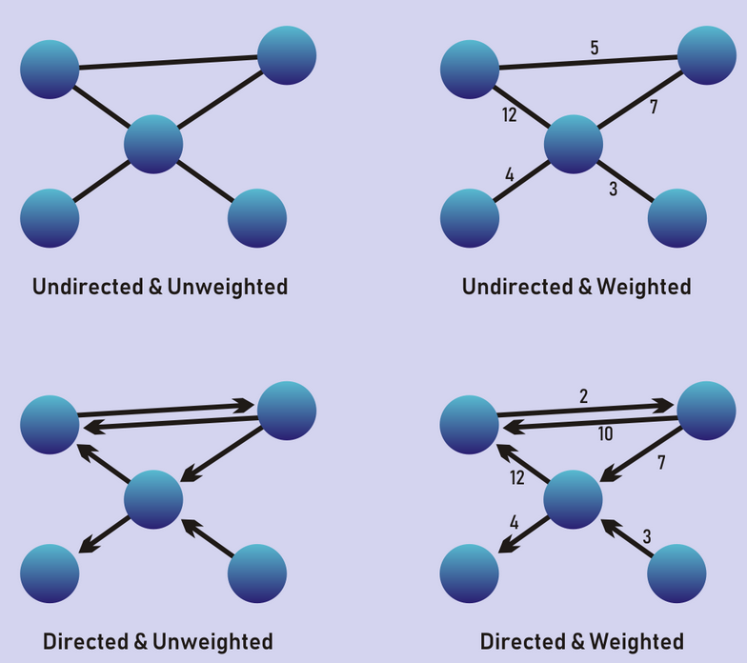

Slide 14
Maximum Spanning Trees
Maximum Spanning Trees:
A maximum spanning tree is a spanning tree having
maximum weight.
The weight of a tree is just the sum of weights of its edges.

Slide 15
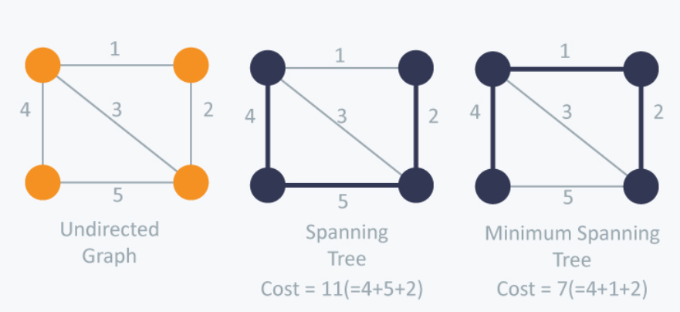
Maximum Spanning Trees
The minimum spanning tree of a weighted graph is a set of edges of minimum total weight which form a spanning tree of the graph.
When a graph is unweighted, any spanning tree is a minimum spanning tree.

Slide 16
MINIMUM SPANNING TREES
A minimum spanning tree in a connected weighted graph is a spanning tree that has the smallest possible sum of weights of its edges.
Two algorithms for constructing minimum spanning trees:
Kruskal’s Algorithm
Prim’s Algorithm

Slide 17
MINIMUM Spanning Tree Algorithms
Both algorithm use Greedy approach
A greedy algorithm is a procedure that makes an optimal choice at each of its steps
Greedy algorithms try to find a localized optimum solution, which may eventually lead to globally optimized solutions.
Generally greedy algorithms do not provide globally optimized solutions.
Both algorithms used for constructing minimum spanning trees are greedy algorithms that do produce optimal solutions.

Slide 18
Kruskal's Algorithm
Steps of algorithm are:
Remove all loops and Parallel Edges
In case of parallel edges, keep the one which has the least cost associated and remove all others.
Arrange all edges in their increasing order of weight
Add the edge which has the least weightage
Start adding edges to the graph beginning from the one which has the least weight. Keep checking that the spanning properties remain intact.
In case, by adding one edge, the spanning tree property does not hold then we shall consider not to include the edge.

Slide 19
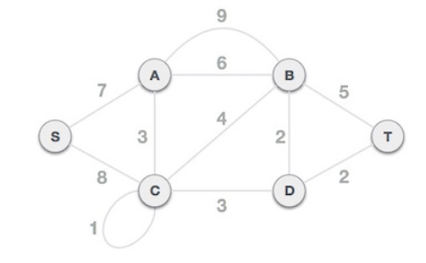
Kruskal's Algorithm
Consider the following graph:
Vertices = 6
Edges = 11
MST = 5

Slide 20
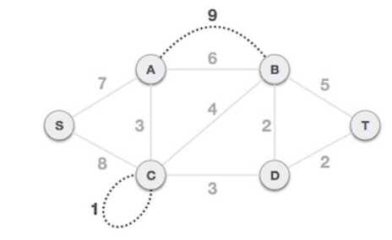
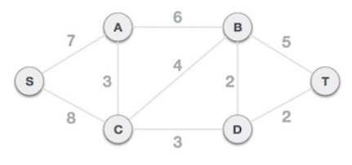
Kruskal's Algorithm
Step 1 - Remove all loops and Parallel Edges
In case of parallel edges, keep the one which has the least cost associated and remove all others.

Slide 21
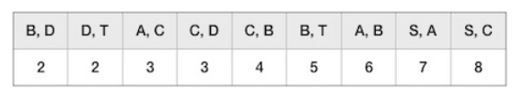
Kruskal's Algorithm
Step 2 - Arrange all edges in their increasing order of weight
The next step is to create a set of edges and weight, and arrange them in an ascending order of weightage (cost).

Slide 22

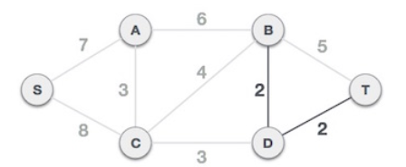
Kruskal's Algorithm
Step 3 - Add the edge which has the least weightage
Start adding edges to the graph beginning from the one which has the least weight.
In case, by adding one edge, the spanning tree property does not hold then we shall consider not to include the edge in the graph.
The least cost is 2 and edges involved are (B,D) and (D,T)
Add the edges.
Adding them does not violate spanning tree properties, so we continue to our next edge selection.

Slide 23
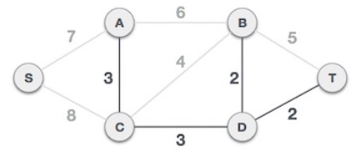
Kruskal's Algorithm
Step 3 - Add the edge which has the least weightage
Next cost is 3, and associated edges are (A,C) and (C,D).
Add the edges.
Adding them does not violate spanning tree properties, so continue to our next edge selection.

Slide 24
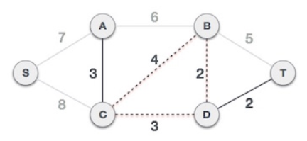

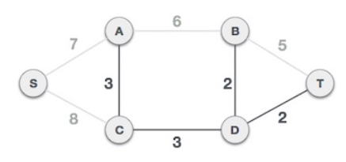
Kruskal's Algorithm
Step 3 - Add the edge which has the least weightage
Next cost in the table is 4, observe that adding it will create a circuit in the graph.
Ignore the edge. Ignore/avoid all edges that create a circuit.

Slide 25
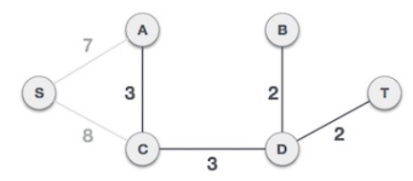
Kruskal's Algorithm
Step 3 - Add the edge which has the least weightage
Observe that edges with cost 5 and 6 also create circuits.
Ignore them and move on.

Slide 26
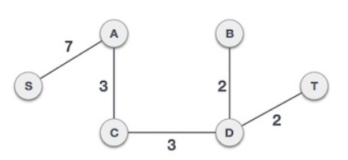
Kruskal's Algorithm
Step 3 - Add the edge which has the least weightage
Only one node to be added. Between the two least cost edges available 7 and 8, we shall add the edge with cost 7.
By adding edge S,A all the nodes of the graph are included.
Minimum cost spanning tree is calculated.

Slide 27
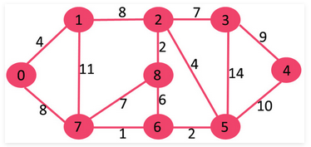
Kruskal's Algorithm
The graph contains 9 vertices and 14 edges.
MST (9 – 1) = 8 edges

Slide 28
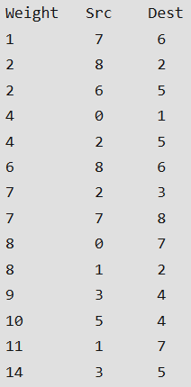
Kruskal's Algorithm

Slide 29

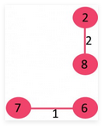
Kruskal's Algorithm
1. Pick edge 7-6: No cycle is formed, include it.
2. Pick edge 8-2: No cycle is formed, include it.

Slide 30
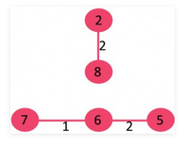
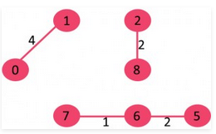
Kruskal's Algorithm
3. Pick edge 6-5: No cycle is formed, include it.
4. Pick edge 0-1: No cycle is formed, include it.

Slide 31
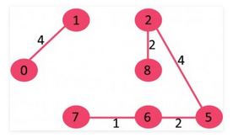
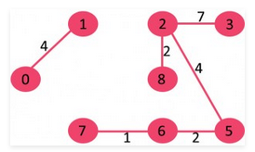
Kruskal's Algorithm
5. Pick edge 2-5: No cycle is formed, include it.
6. Pick edge 8-6: Since including this edge results in cycle, discard it.
7. Pick edge 2-3: No cycle is formed, include it.

Slide 32
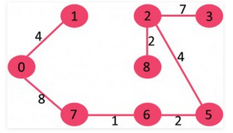
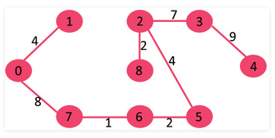
Kruskal's Algorithm
8. Pick edge 7-8: Since including this edge results in cycle, discard it.
9. Pick edge 0-7: No cycle is formed, include it.
10. Pick edge 1-2: Since including this edge results in cycle, discard it.
11. Pick edge 3-4: No cycle is formed, include it.
Since the number of edges included equals (V – 1), the algorithm stops here.

Slide 33
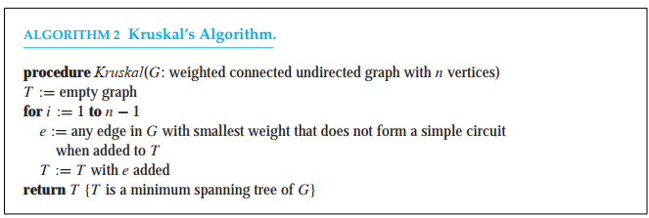
KRUSKAL’S ALGORITHM
To find a minimum spanning tree of a graph with m edges and n vertices, Kruskal’s algorithm can be carried out using O(m log m) operations
It is preferable to use Kruskal’s algorithm for graphs that are sparse, that is, where m is very small compared to the total number of possible edges in an undirected graph with n vertices.

Slide 34
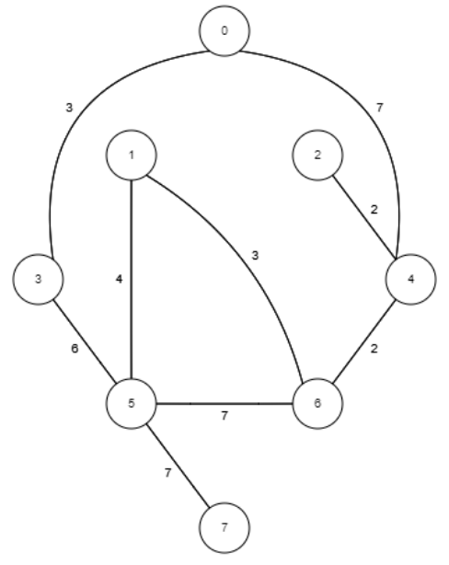
Node 1 | Node 2 | Weight

